Slide 1
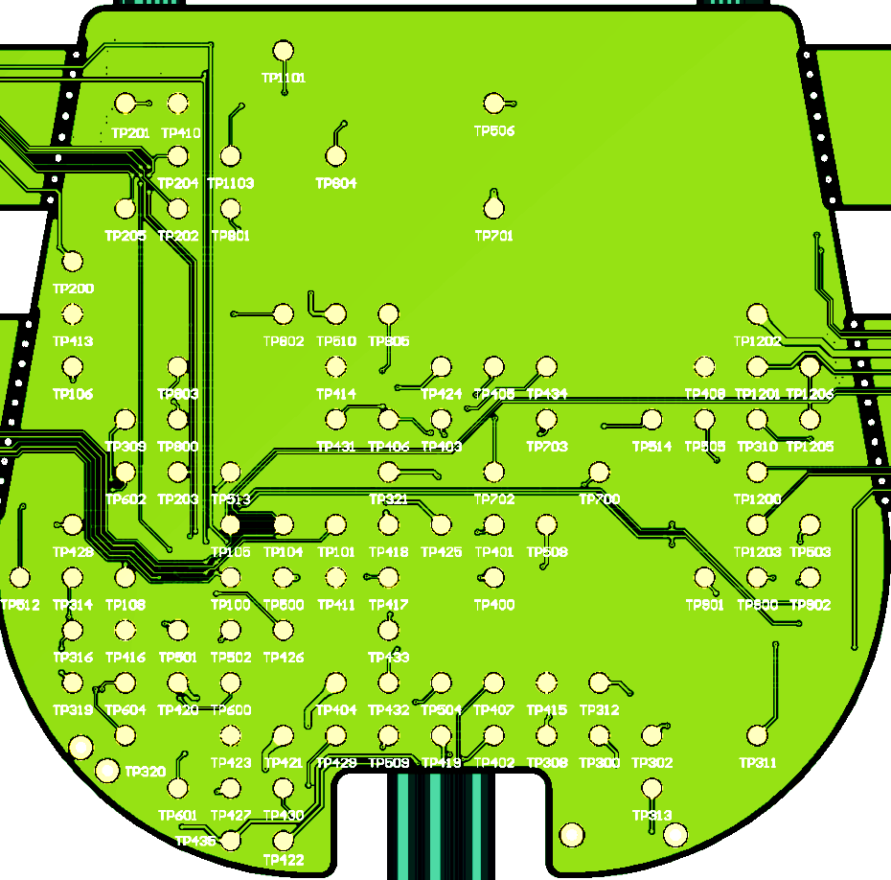
# | Name | TP | V
1 | VPP | TP506 | 5.0
2 | VIMP_3V3 | TP701 | 0
3 | VDD_BLE | TP200 | 3.3
4 | VDDA | TP510 | 3.3
5 | VBAT1F | TP403 | 3.7
6 | VCHG_RAIL | TP321 | 0.2
7 | VBAT2CHG | TP418 | 0
8 | NetC420_1 | TP417 | 0
9 | VBAT1CHG | TP401 | 0
10 | VDDS | TP508 | 3.3
11 | NetC400_1 | TP400 | 0
12 | HVOUT | TP505 | 5.0
13 | VRECT.MON | TP310 | 0.1
14 | HVIN | TP503 | 3.3
15 | VBAT2F | TP420 | 2.2
16 | VRECT | TP308 | 0
17 | HVSW_EN | TP509 | 3.3
18 | DVDD | TP501 | 3.3
19 | HV_EN | TP513 | 3.3
20 | VPPSW_EN | TP514 | 3.3
1
2
3
4
5
20
12
13
19
6
7
9
10
14
8
11
18
USB
15
17
16
J1101
4
1
J424
4 - 2
J421
4 - 2
J302
4 - 2
G
G

